Slide 1
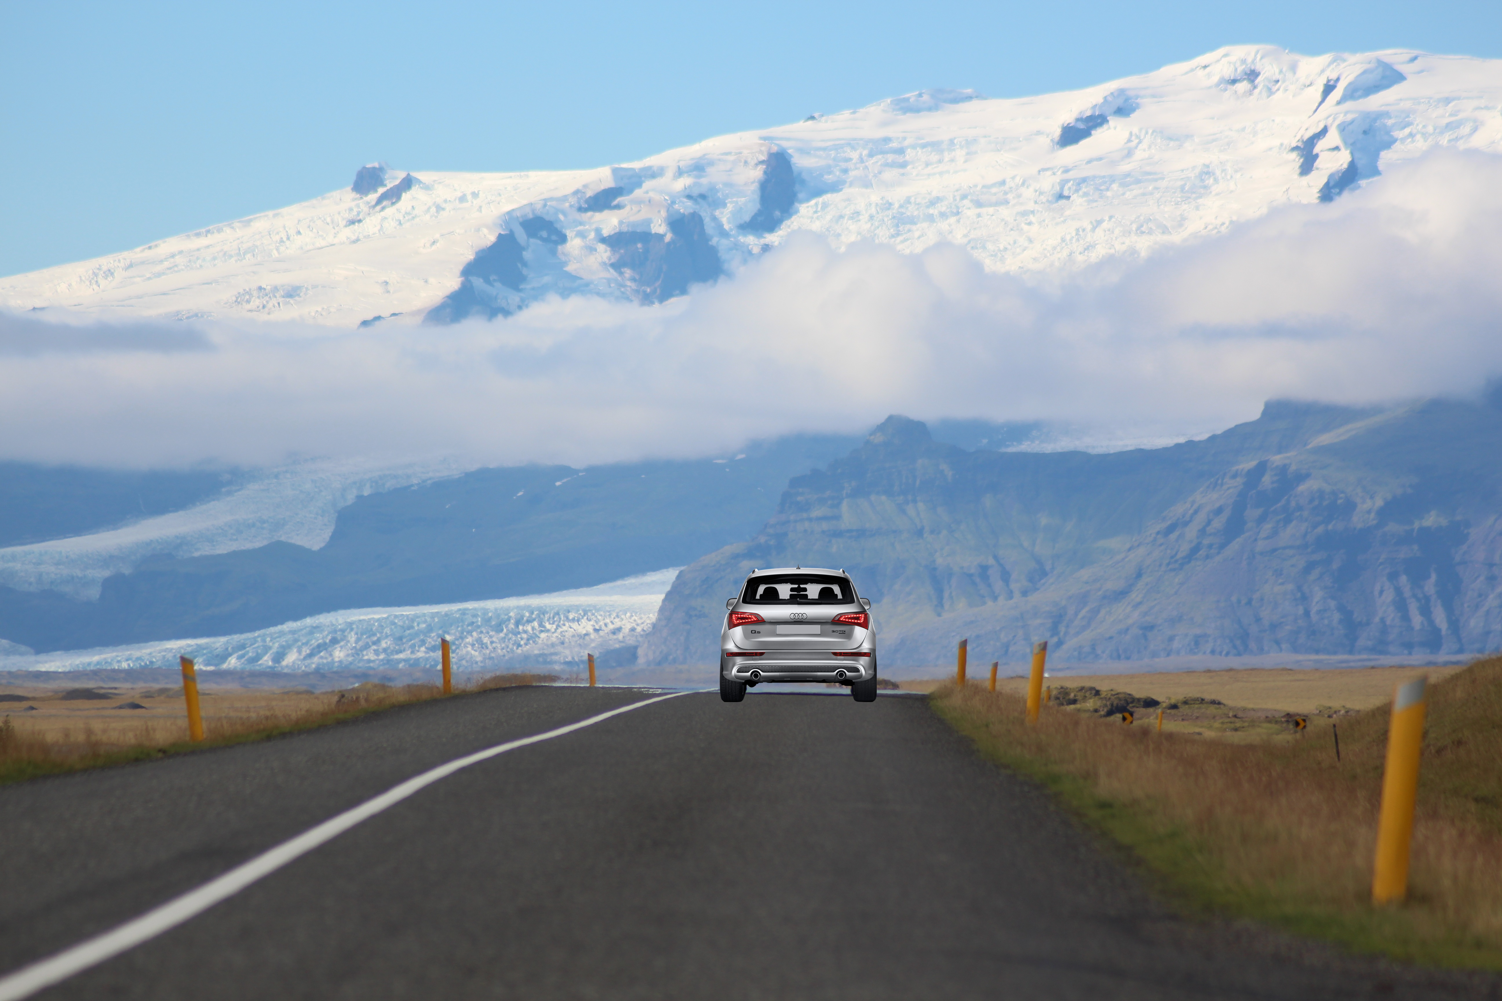
drivemo
Hear your surrounding

Slide 2
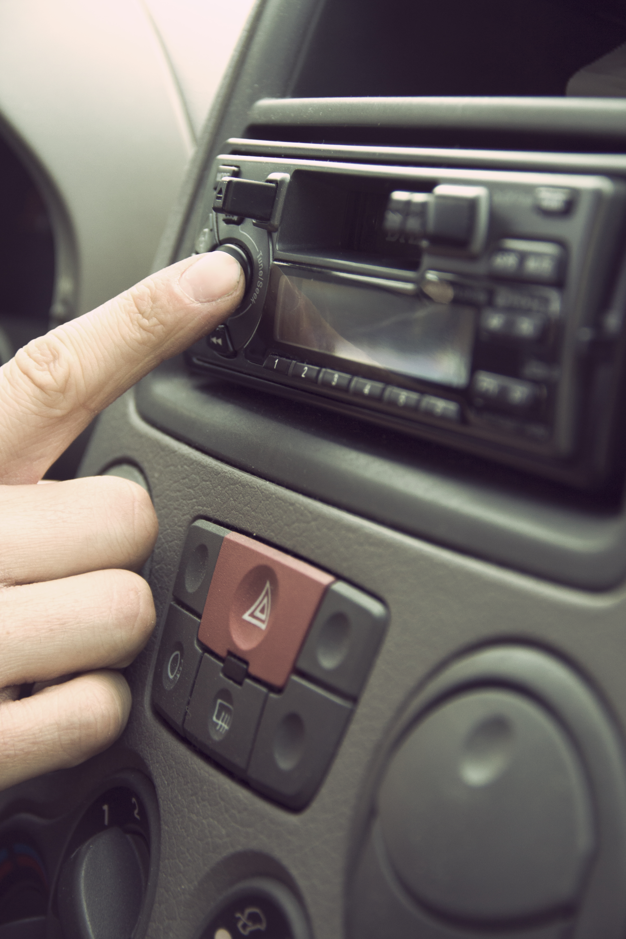
Enjoy listening to music tuned on your mood

Slide 3
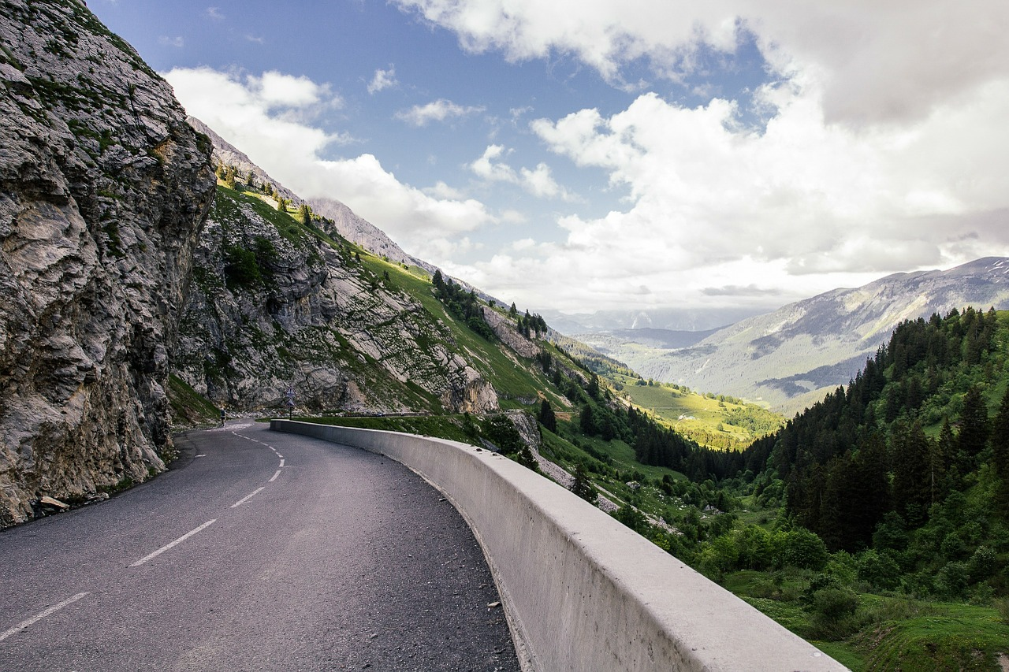
Connect with your surrounding

Slide 4


drivemo – hear your surrounding
Classification of the environment
Selection of songs according to your environment
Autoplay of top choices

Slide 5




Architecture
Frontend
ConvNet
Song DB

Slide 6
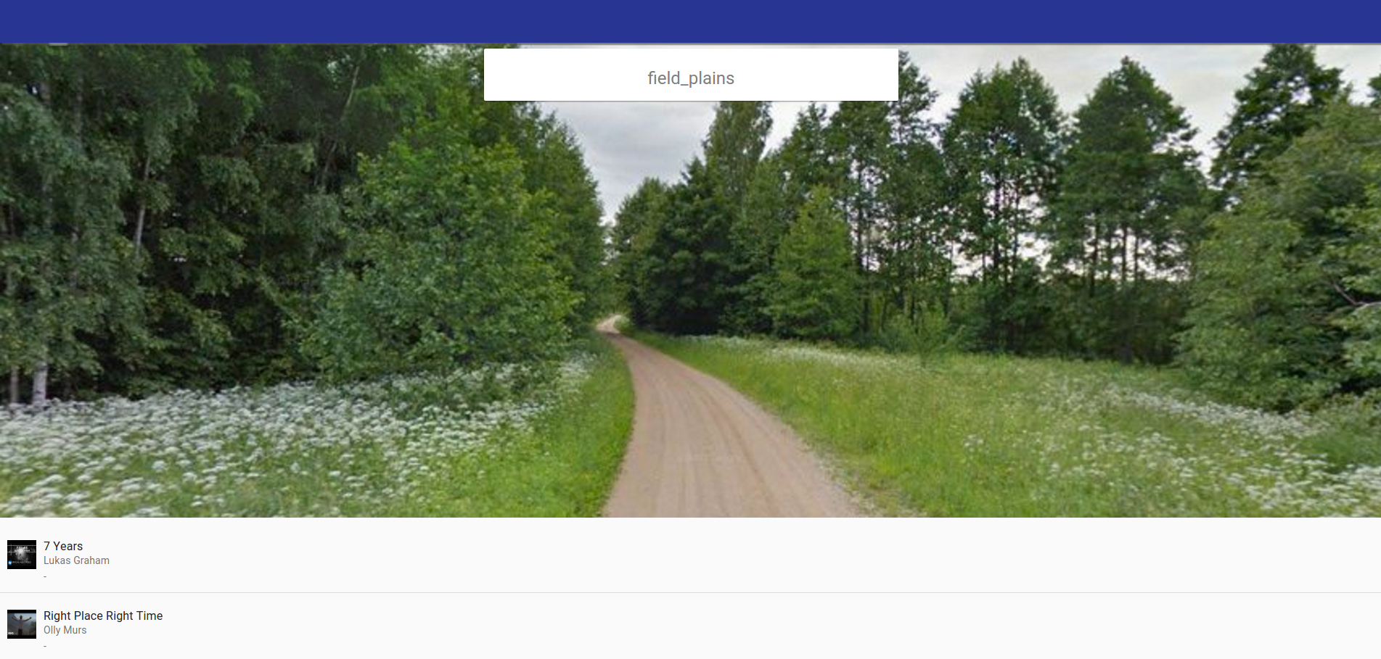
Demo

Slide 7
drivemo
Hear your surrounding

